Slide 1



Slide 2
Executive Summary:
This research analysis report was designed to help Hopeside Home of Half Moon Bay in expanding and being able to help more people in the process. The analysis from this report will help Hopeside Hope in recieving more aid and money from the county and state to be able to be a more organized and structured organization. It will also be able to give Coastside Hope an idea of what their employees and volunteers feel about the enviorment of the organization and how they can retain these nonprofit workers in Halfmoon Bay. We conclude, based on our findings, that employees are happy working for the organization and are mostly sticking to the job description, but there are some employees that feel a bit overwhelemed with the workload.

Slide 3
2020 Hopeside Home of Halfmoon Bay

Slide 4
Research objectives and hypotheses:
The specific research objectives of this study were as follows:
I. Determine whether employees and Volunteers are happy and are not being overworked with the organization Coastside Hope.
II. Evaluate whether employyes are not being overworked and what can help retain employees using qualitative data (a survey)
Our management problem was to determine empoyee retention at Hopeside Hope. Our reaesrch probelm was to see if the employees and volunteers are happy working for the organization. We expect employees to be overworked and are doing work outside of their job descripton, but are henerally happy because they are helping alot of people in need. We also expect Coastside Hope to need more employees to be able to give more structure to the organization which will cause them to genrally be able to help more people.

Slide 5
Research Methodology:
There were three steps in our research methodology for our analysis for Hopeside Hope. The first step was to meet with the Coastside Manager and ask questions, basically conducting an interview with her trying to extract what her goal was and some quantitative data. Such as the number of employees working and the number of clients they help. Also how many volunteers they work with and typically hours they work. The second step was to use the data from the surveys to construct a survey that could be handed out to the employees at Hopeside Hope to obtain qualitative data to use to do the analysis.. The third step was to conduct an analysis of the survey.

Slide 6

Annotated Bibligraphy

Slide 7
Fong, K., Wright, R. A., & Wimer, C. (2016)
Harrison, G. G, DiSogra, C. A, Manolo-LeClair, G., Aguayo, J., &amp; al., E. (2002).
Marcus, J., &amp; Zuk, M. (2017).
Nicoll, K. L. (2015).
Ogliastri, E., Jäger, U., P., & M Prado, Andrea. (2016).
Wicker, P., & Frick, B. (2016).

Slide 8
Population

Slide 9
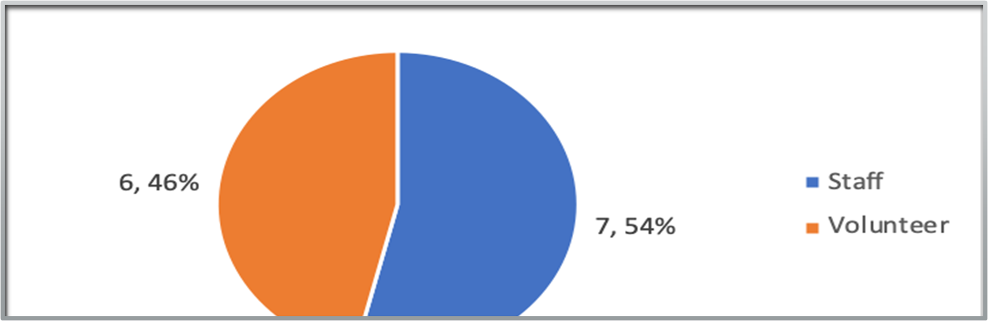
Affiliation
46% of the people who took the survey are Volunteers
54% of the people who took the survey are Staff members

Slide 10
How much time spent
2 People worked more than 40
2People worked 36-40 hours
1 Person worked 26-30
1Person worked 11-15
5People worked 1-5
1 Person didn't work.
Population = 13
Mean = 17.692307692308

Slide 11
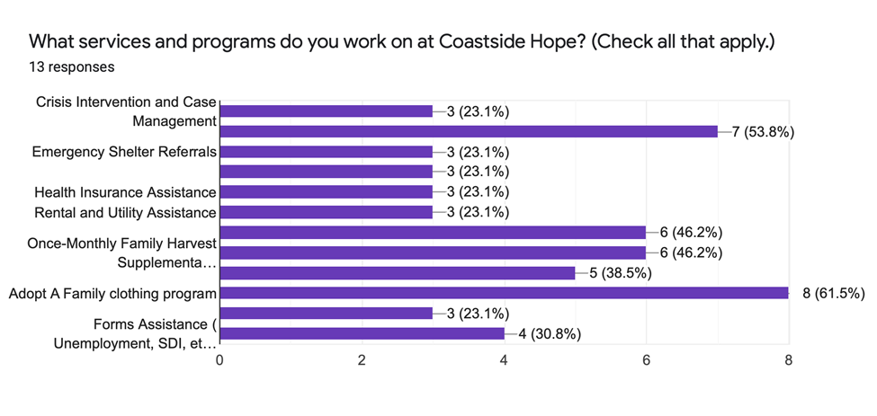
Write a slide for each correlation strength.

Slide 12
Received a Job Description
On a scale of 1-5, where 1 equals disagree and 5 equals agree, the average response to the statement, “When I began working at Coastside Hope, I received a job description,” was somewhat agree to agree, (m=4.23, sd = 1.48).

Slide 13
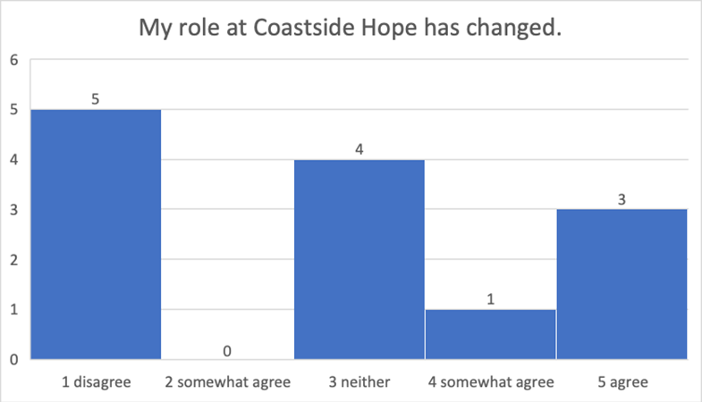
Descriptive Statistics
On a scale of 1 to 5, majority of the respondents reported that their roles at Coastside Hope didn’t change. The average response was 2.6, which clearly indicates that most respondents somewhat agreed to disagree with the statement.

Slide 14
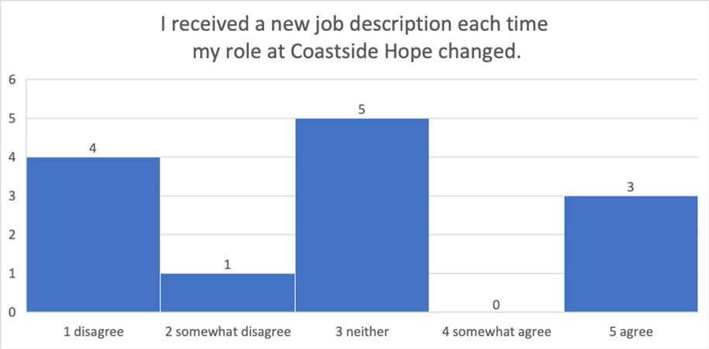
Produce a slide with commentary for every histogram
Out of the total respondents, 30.8% reported that even after having their roles changed, they retained their job descriptions while 7.7% of the respondents somewhat disagreed. 38.4% were neutral; they did not agree or disagree while 23.1% agreed with the statement and this is to say that they were satisfied with the roles they signed up for.

Slide 15
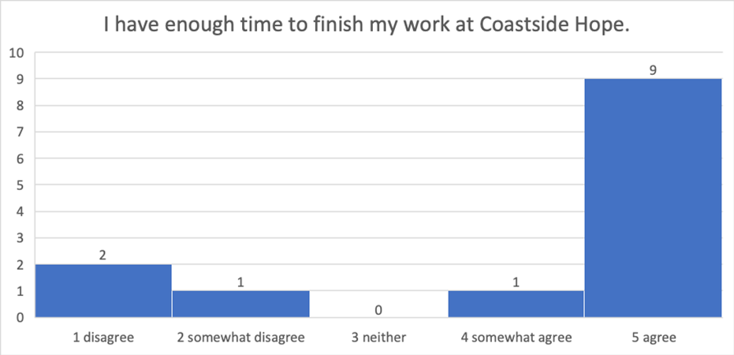
Correlations
Respondents were asked whether they have enough time to finish their work at Coastside Hope. The results shows that 69.2% agreed with statement while 15.3% disagreed. 7.7% of the respondents somewhat agreed with the statement while 7.7% somewhat disagreed.

Slide 16
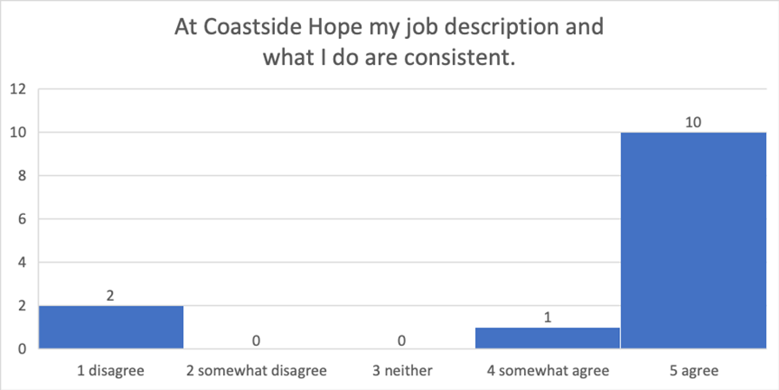
Respondents were asked to report whether or not their job description at Coastside Hope are consistent with what they do. Majority of them(77%) agreed that their job description and what they do are consistent while 15.3% disagreed. Also, 7.7% of respondents somewhat agreed with the statement which is to say that though not sure, their job description and what they do are consistent.

Slide 17
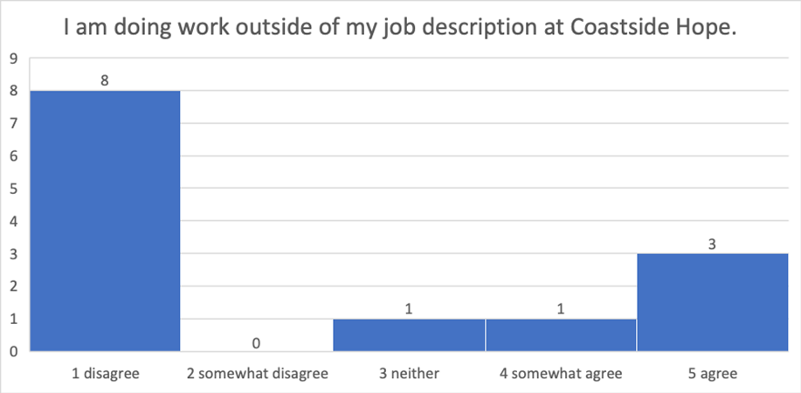
Respondents were asked to report whether or not they were doing work outside their job description at Coastside Hope. The results indicates that 61.5% of the respondents were not doing any work outside their job descriptions while 23.0% agreed with the statement. 7.7% of the respondents somewhat agreed while the remaining 7.7% somewhat disagreed.

Slide 18
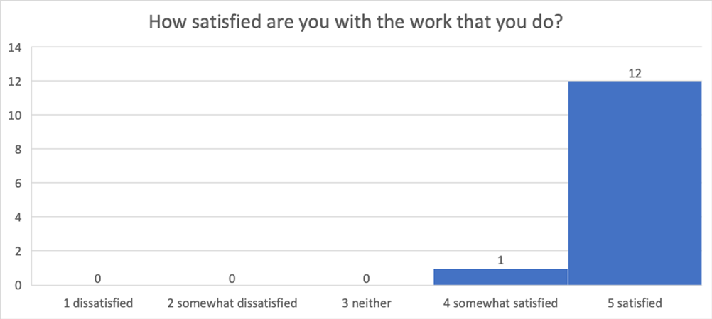
Respondents were asked to report to what extent they are satisfied with the work they do. The results indicate that 92.3% were satisfied while 7.7% of respondents reported that they were unsatisfied.

Slide 19
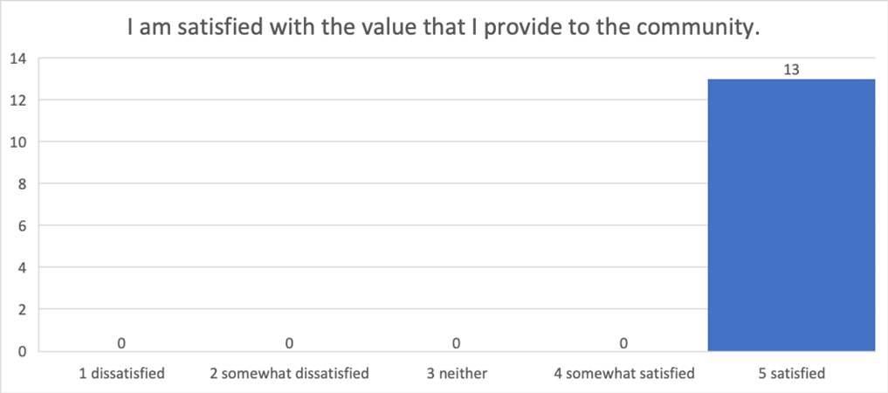
Respondents were asked to report the extent to which they are satisfied with the value they provide to the community. All of the respondents (100%) reported that they are satisfied with the value they provide.

Slide 20
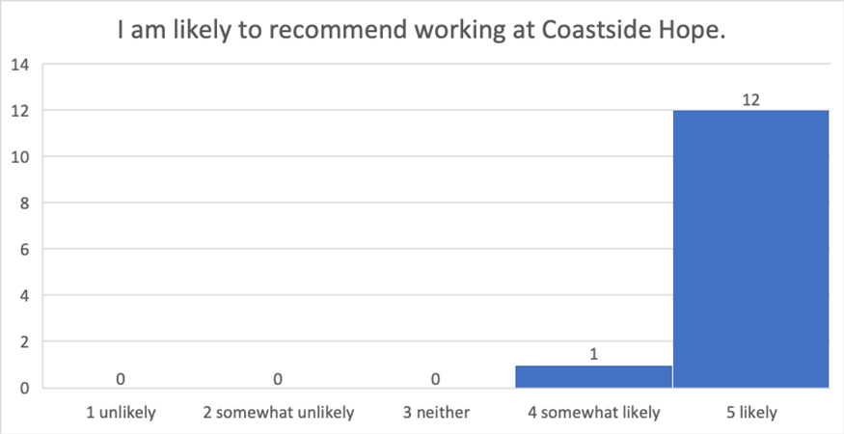
Respondents were asked to report to what extent they are likely to recommend working at Coastside Hope. Results indicate that 92.3% of the respondents reported that they are more likely to recommend working there while 7.7% reported that they are less likely to recommend.

Slide 21
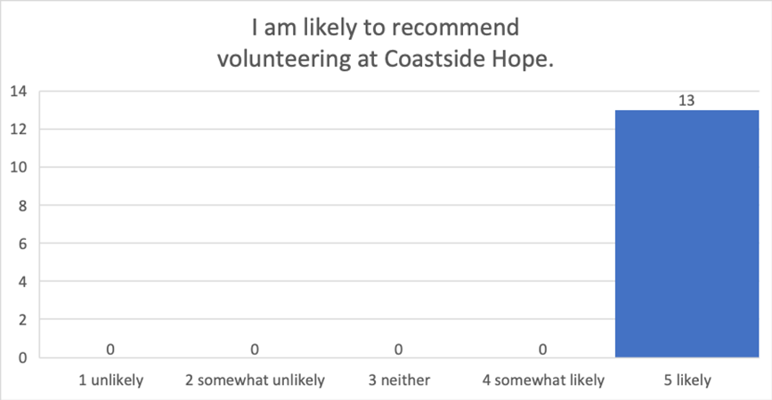
Respondents were asked to report how likely they are to recommend volunteering at Coastside Hope. Results indicated that all of them (100%) are likely to recommend.

Slide 22
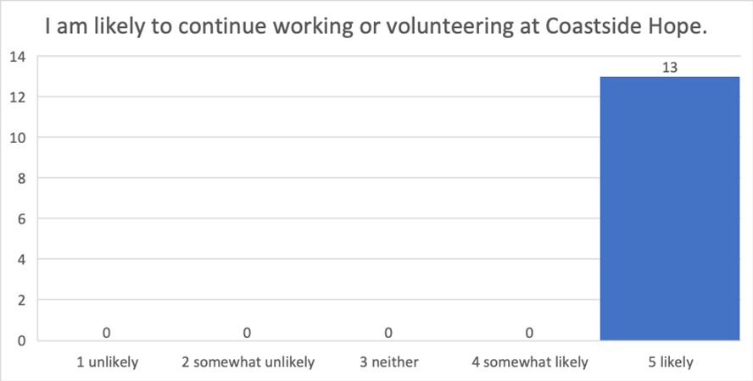
Respondents were asked to report how likely they are to continue working or volunteering at Coastside Hope. All of them(100%) reported that they are more likely to continue working or volunteering at Coastside Hope. These results clearly indicate that the organization had been fostering a happy working environment and, therefore, majority of its employees are satisfied.

Slide 23
 | Staff | Volunteer | When I began working, I received a job description. | My role at Coastside Hope has changed. | I received a new job description each time my role changed. | I have enough time to finish my work. | My job description and what I do are consistent. | I am doing work outside of my job description . | I am satisfied with the work that I do. | I am satisfied with the value that I provide to the community by working with Coastside Hope. | I am likely to recommend working at Coastside Hope | I am likely to recommend volunteering at Coastside Hope | I am likely to continue working or volunteering at Coastside Hope
Staff | 1.00
Volunteer | -1.00 | 1.00
When I began working, I received a job description. | -0.28 | 0.28 | 1.00
My role at Coastside Hope has changed. | 0.16 | -0.16 | -0.56 | 1.00
I received a new job description each time my role changed. | -0.25 | 0.25 | 0.50 | -0.19 | 1.00
I have enough time to finish my work. | -0.45 | 0.45 | 0.83 | -0.40 | 0.65 | 1.00
My job description and what I do are consistent. | -0.34 | 0.34 | 0.98 | -0.61 | 0.51 | 0.86 | 1.00
I am doing work outside of my job description . | 0.43 | -0.43 | -0.59 | 0.65 | -0.46 | -0.47 | -0.63 | 1.00
I am satisfied with the work that I do. | -0.39 | 0.39 | 0.97 | -0.60 | 0.51 | 0.85 | 0.98 | -0.66 | 1.00
I am satisfied with the value that I provide to the community by working with Coastside Hope. | #DIV/0! | #DIV/0! | #DIV/0! | #DIV/0! | #DIV/0! | #DIV/0! | #DIV/0! | #DIV/0! | #DIV/0! | 1.00
I am likely to recommend working at Coastside Hope | 0.31 | -0.31 | -0.16 | 0.32 | 0.35 | -0.17 | -0.14 | 0.22 | -0.12 | #DIV/0! | 1.00
I am likely to recommend volunteering at Coastside Hope | #DIV/0! | #DIV/0! | #DIV/0! | #DIV/0! | #DIV/0! | #DIV/0! | #DIV/0! | #DIV/0! | #DIV/0! | #DIV/0! | #DIV/0! | 1.00
I am likely to continue working or volunteering at Coastside Hope | #DIV/0! | #DIV/0! | #DIV/0! | #DIV/0! | #DIV/0! | #DIV/0! | #DIV/0! | #DIV/0! | #DIV/0! | #DIV/0! | #DIV/0! | #DIV/0! | 1.00

Slide 24
Strong Correlations
There is a direct, strong correlation between the variables “I am satisfied with the work that I do.” vs. “My job description and what I do are consistent” (r = 0.98, p. < 0.05).
There is a strong correlation between “Satisifed with the work I do” and “volunteering”(r=0.39p<0.05)
There is a strong correlation between “Satisifeid at work” and “receiving a job description”(r=0.97p<0.05)
There is a strong correlation between Satisfied at work and having enough time to finish the work(r=0.85<0.05)
There is a direct correlation between what my job description is and What I do are consistent (r=0.98 p<0.05)
There is a strong correlation between what my job description is and the role has changed. (r=0.65 p<0.05)

Slide 25
There is a correlation between doing work outside my job description and being staff (r=0.43 p<0.05)
There is dirt correlation between doing work outside mu job description and my role has changed at Coast side Hope(r= 0.65 P<0.05)
There is a correlation between my job description is what I do and volunteering (r=0.34 p<0.05)
There is a strong correlation between receiving a job description and my job description and what I do a re consistent (r=0.98 p<0.05)
There isa correlation between my job description and what I do are consistent and finishing my work on time(r=0.86 P<0.05)

Slide 26
There is a direct correlation between recommending to work at Coastside Hope and my role has changed (r=0.32 P<0.05)
There is correlation between reccomendinf someone to work at Coastside Hope and being Staff. (r=0.31 P<0.05)
There is a direct correlation between I am likely to reccoemn to work there and receiving a new job description overtime the roles changes(r=0.35 P<0.05)
Direct Correlation between working at Coastside Hope and doing work outside the job description (r=0.22P<0.05)
There is a correlation between my role at coast side hope has changed and being staff(r=0.16P<0.05)

Slide 27
Conclusion
Reference
Fong, K., Wright, R. A., & Wimer, C. (2016). The cost of free assistance: Why low-income individuals do not access food pantries. J. Soc. & Soc. Welfare, 43, 71.
Harrison, G. G, DiSogra, C. A, Manolo-LeClair, G., Aguayo, J., &amp; al., E. (2002). Over 2.2 Million Low-Income California Adults are Food Insecure; 658,000 Suffer Hunger. UCLA: Center for Health Policy Research. Retrieved from https://escholarship.org/uc/item/3cn8b0rz
Marcus, J., &amp; Zuk, M. (2017). Displacement in San Mateo County, California: Consequences for Housing, Neighborhoods, Quality of Life, and Health, 1–15. Retrieved from: https://escholarship.org/content/qt0n904028/qt0n904028.pdf
Nicoll, K. L. (2015). Why do eligible households not participate in public anti-poverty programs?: A review. Journal of Poverty, 19(4), 445-465.
Ogliastri, E., Jäger, U., P., & M Prado, Andrea. (2016). Strategy and structure in high- performing nonprofits: Insights from Iberoamerican cases. Voluntas, 27(1), 222-248. doi:http://dx.doi.org/10.1007/s11266-015-9560-8
Wicker, P., & Frick, B. (2016). Recruitment and retention of referees in nonprofit sport organizations: The trickle-down effect of role models. Voluntas, 27(3), 1304-1322. doi:http://dx.doi.org/10.1007/s11266-016-9705-4

Slide 28
Compare some correlations to articles that you read for the annotated bibliography assignment.
Lorum
Lorum
Lorum

